Slide 1
Regression

Slide 2
ANNOUNCEMENTS Capstone Framing Document
Application to complete a Track 2 (individual project) deadline is May 21st, 2020
Framing document is located on the DSDP Participant SharePoint site under the “Capstone” link
Highlighted sections are required to be completed
Email completed framing document to DataScienceDevelopmentProgram@Chevron.com
Notification of acceptance to Track 2 will be emailed on July 10, 2020

Slide 3
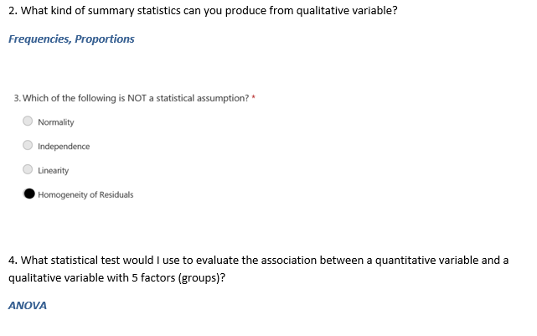
Homework Review Basic Statistics

Slide 4
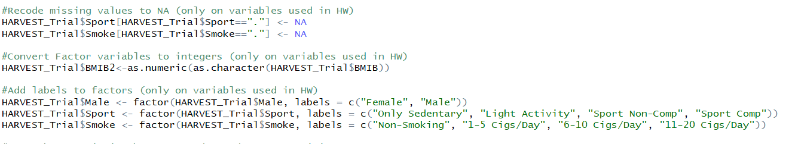
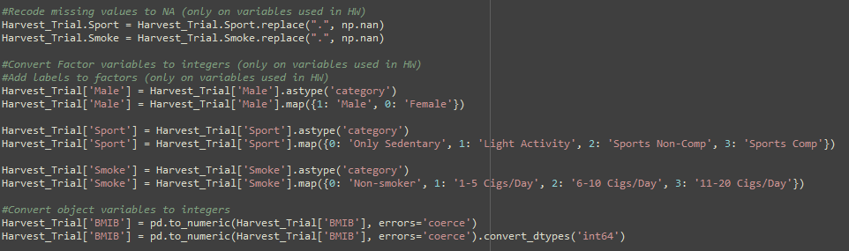
Homework Review Basic Statistics
A tip….

Slide 5
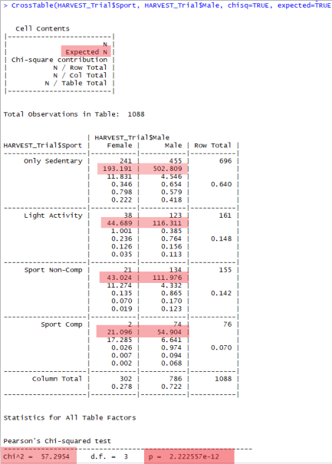
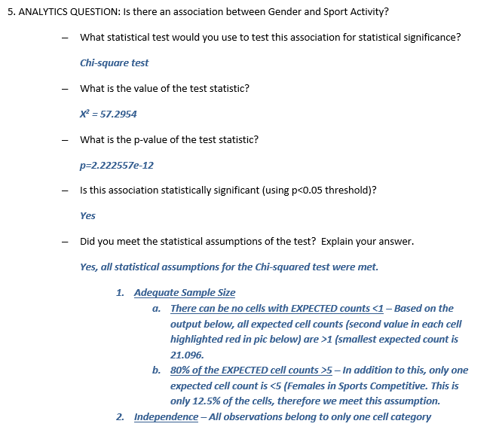
Homework Review Basic Statistics

Slide 6
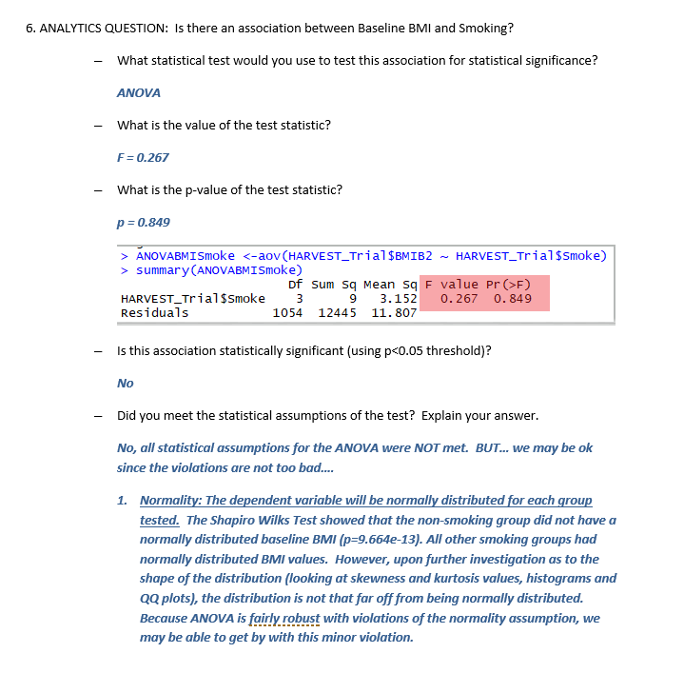
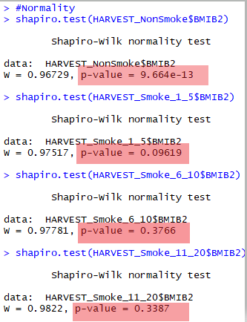
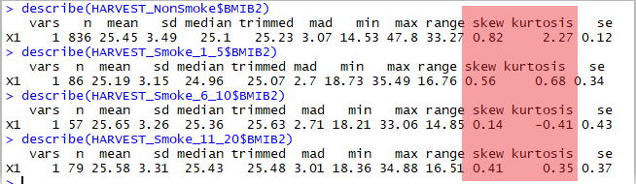
Homework Review Basic Statistics

Slide 7
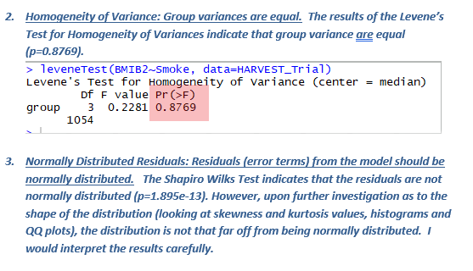
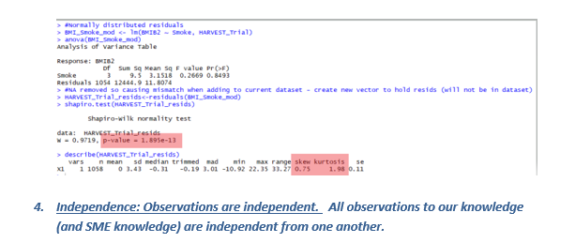
Homework Review Basic Statistics

Slide 8
Overview: Data Analysis
The methodology you choose will depend on
Your goal (the analytics question)
Your data (type)
Type | Questions
Descriptive | What happened? What is happening?
2) Exploratory | What might be the pattern/reason for it happening?
3) Diagnostic | Why/how did it happen?
4) Predictive | What could happen?
5) Prescriptive | What should I do? How can I make it happen?
Data Analysis
I. Business Problem (Question) Framing
VI. Deployment
VII. Model Lifecycle Management
II. Analytics Problem Framing
III. Data
IV. Methodology
V. Model Building

Slide 9
Regression Analysis
What is regression analysis?
A set of statistical processes for estimating the relationships among variables
Focus is on the relationship between dependent variables (DV) and independent variables (IV)
Helps one to understand how the typical value of the DV changes when one of the IV is varied while the other IV (if in the model) remain fixed.

Slide 10
Least Squares
Observed Values
y = β₀ + β₁ x₁
Predicted Values
β₁ = slope
Y (Dependent Variable)
y₁ – (β₀ + β₁ x₁)
Σ[y_{i} – (β₀ + β₁ x₁)]²
(x_{1 ,} y₁)
β₀ = y-intercept
y₁
x₁
X (Independent Variable)

Slide 11
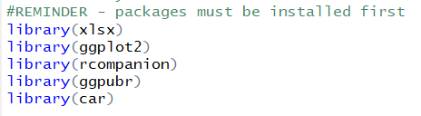
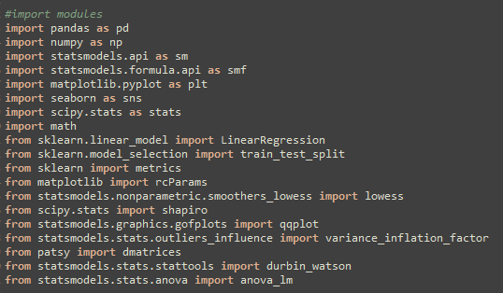
Packages and Data Used for Today’s Class
Dataset: GraduateEarnings.xlsx

Slide 12
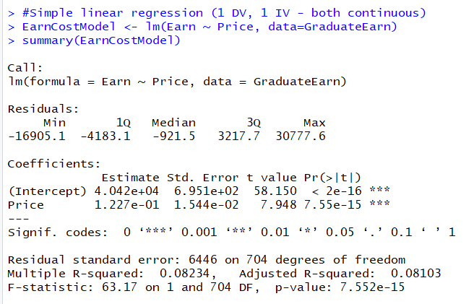
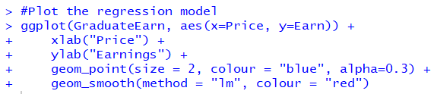
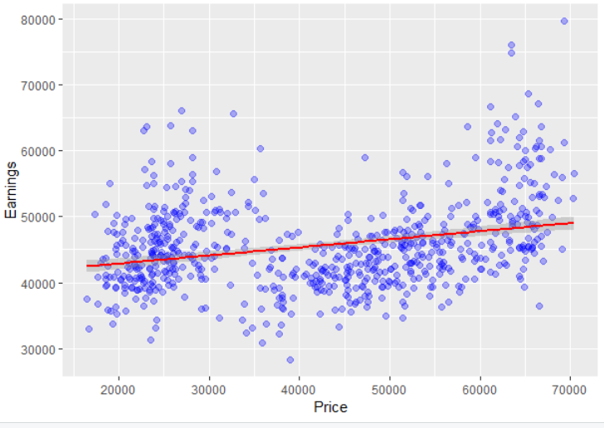
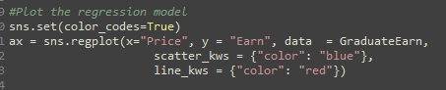
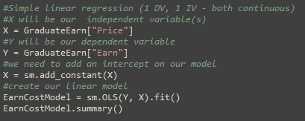
Simple Linear Regression (One DV and One IV, Interpretation)
1. p <0.05, we reject the null hypothesis, there is a statistically significant association between price of college tuition and average earnings 5 years after graduation
2. We estimate that there is a $0.12 increase in earnings for every additional dollar spent on tuition.
Scaling: For every $10,000 increased spend on tuition, there is an associated $1,227 increase in earnings.

Slide 13
Simple Linear Regression (One DV and One IV, Interpretation)
3. Our RSE indicates the amount the DV will deviate from the true regression line. In our case, the mean earnings is ~$40,420 and RSE is $6,446 so the percentage error in our estimate is about 16%.
4. Our R² value indicates that only about 8% of the variation in Earnings (outcome) is explained by the Tuition variable (predictor).
5. However, the model is statistically significant (p<0.05), indicating that it is still useful in describing the relationship between earnings and tuition price (there is a statistical association between earnings and tuition price).

Slide 14
Simple Linear Regression (Prediction – 2 ways)
y = β₀ + β₁ x₁
Earnings = 40,420 + (0.1227 * Price)
Given the price of the school is $55,000, what is the expected earnings at 5 years?
Earnings = 40,420 + (0.1227 * 55,000)
Earnings = $47,169

Slide 15
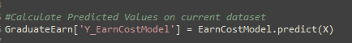
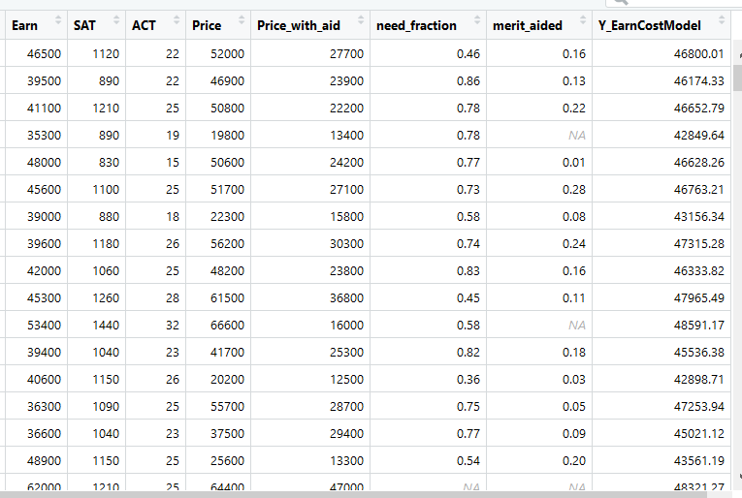
Simple Linear Regression (Prediction – 2 ways)

Slide 16
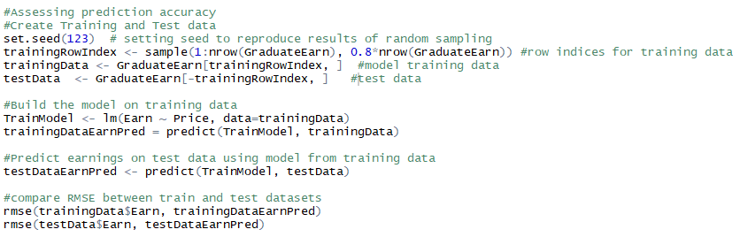
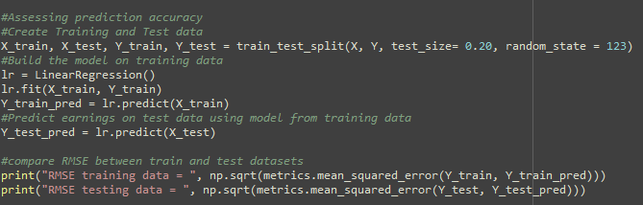
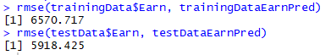
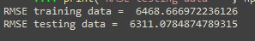
Simple Linear Regression (Predication Accuracy – Train/Test)

Slide 17
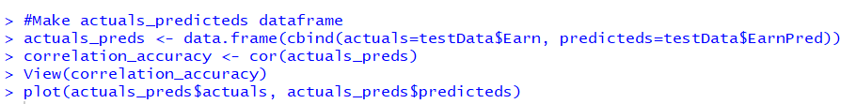
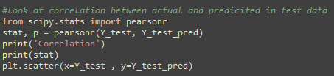
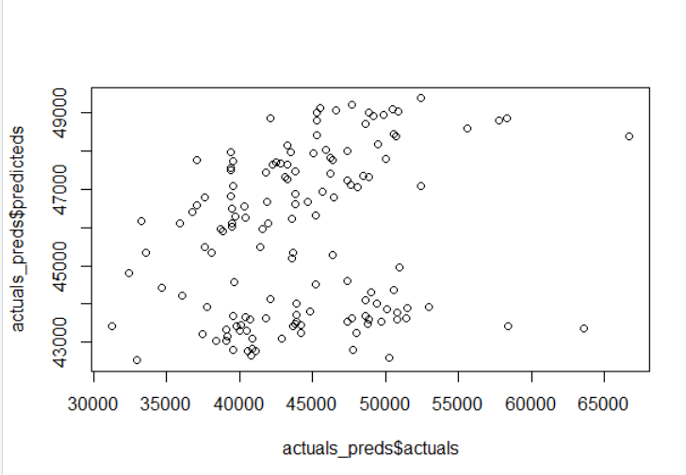
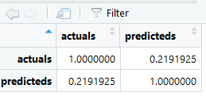
Simple Linear Regression (Predication Accuracy – Train/Test)

Slide 18
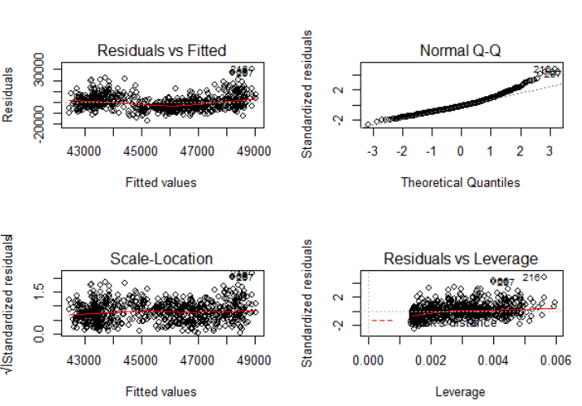
Simple Linear Regression (Diagnostics)
Poking and prodding our model to determine if there are any problems
*look at script posted on SharePoint for how to replicate this with Python
*Many more diagnostic statistics that are not discussed here

Slide 19
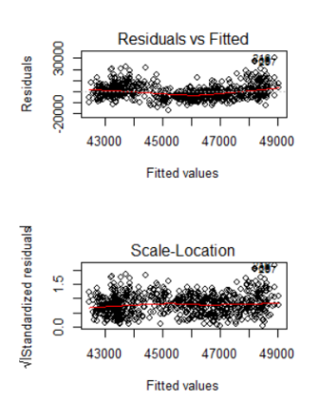
Simple Linear Regression (Diagnostics – Residuals vs Fitted)
Looking for a pattern (indicates lack of fit)
Values both above and below the line
Same as above but residuals are standardized for comparison between models

Slide 20
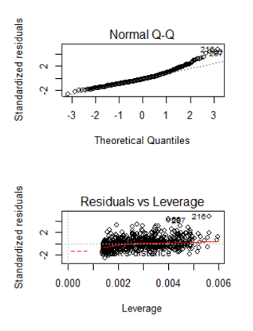
Simple Linear Regression (Diagnostics – Normality, Leverage/Influence)
Assess normality of error terms (error should be normally distributed)
Looking for a pattern (indicates lack of fit)
Any point with high leverage and small residual values could indicate there are data values that are exerting heavy influence in our model (Cook’s Distance)

Slide 21
Statistical Assumptions for Linear Regression
Linearity – relationship between DV and IV should be linear
Normality – all IV* and residuals should be normally distributed*
Multicollinearity – IV should not be highly correlated
Auto-correlation – Residuals should be independent from one another
Homoscedasticity – Residuals should be equal across the regression line

Slide 22
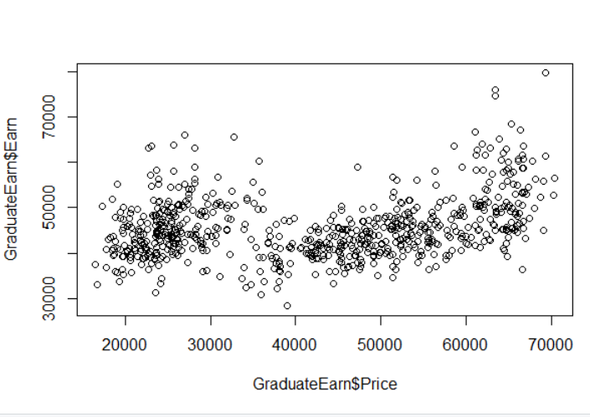
Statistical Assumptions for Linear Regression
Linearity – relationship between DV and IV should be linear

Slide 23
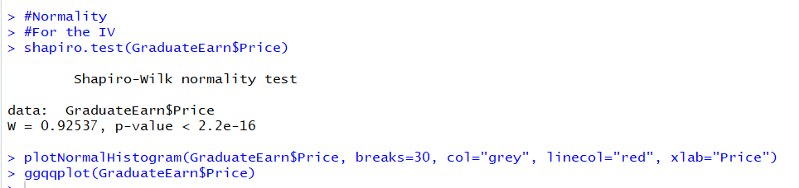
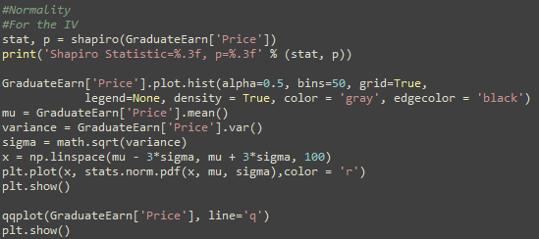
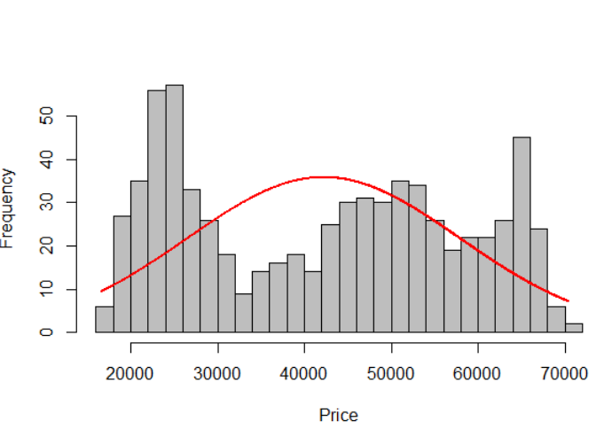
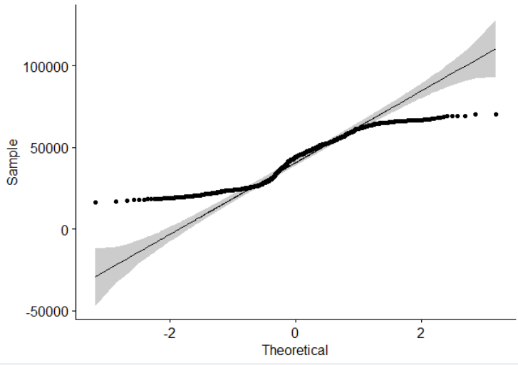
Statistical Assumptions for Linear Regression
Normality – all IV* and residuals should be normally distributed

Slide 24
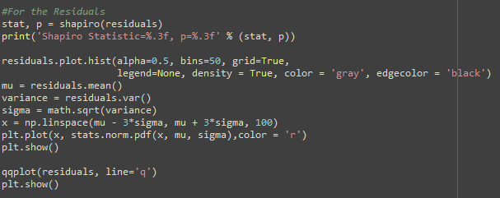
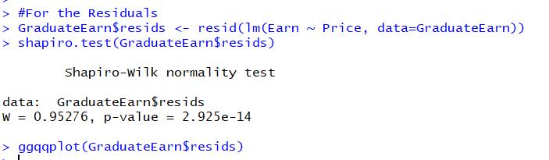
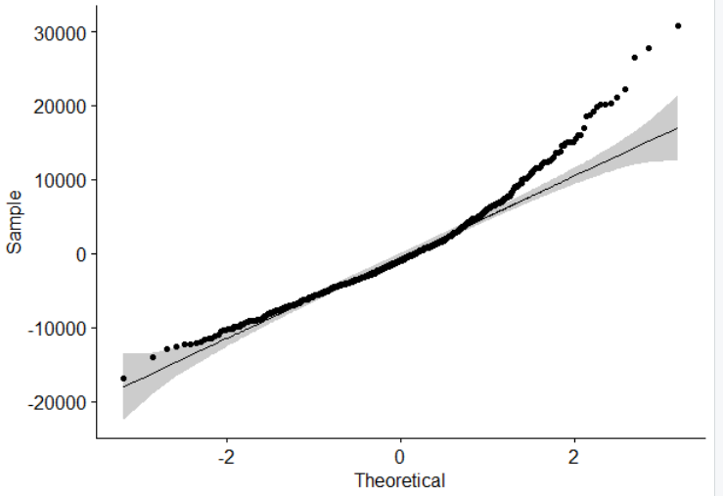
Statistical Assumptions for Linear Regression
Normality – all IV* and residuals should be normally distributed

Slide 25
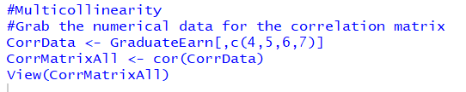
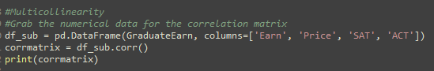
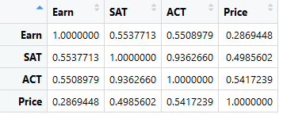
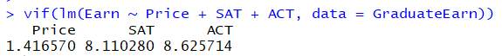
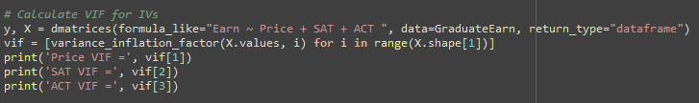
Statistical Assumptions for Linear Regression
Multicollinearity – IV should not be highly correlated
Variance Inflation Factor (VIF) > 10 may indicate multicollinearity

Slide 26
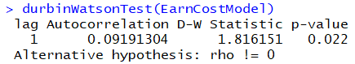
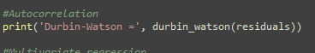
Statistical Assumptions for Linear Regression
Auto-correlation – Residuals should be independent from one another
Durbin Watson Test value 1.5 to 2.5 may indicate no autocorrelation (for more precision look at the p-value)

Slide 27
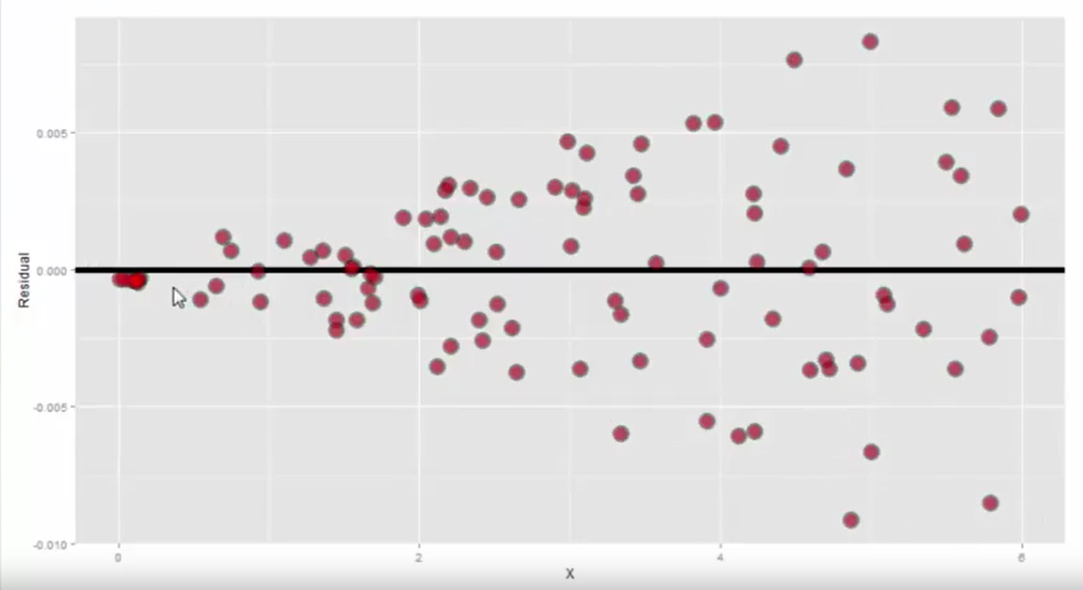
Statistical Assumptions for Linear Regression
Homoscedasticity – Residuals should be equal across the regression line
*From our diagnostics
Example of Heteroscedasticity

Slide 28
Attendance Question
This is the Regression Lecture
What is your favorite hobby?
**Log your answer now on the linked form on the DSDP Participant SharePoint site**

Slide 29
Multivariate Linear Regression
Purpose of multivariate regression is two-fold
Prediction
More than likely, you will need multiple variables to be able to predict your outcome.
We live in a complex world and multiple things are more than likely interacting to influence outcome
Adjustment
If your goal is to better understand the relationship between a variable and a predictor, you many need to “account” for other things in the relationship.
Often times, your explanation of this relationship will not be accepted if you aren’t adjusting (accounting) for other things in the model.
Purchase NEW coffee product
= Time of Day + Age + # kids + Weather
Purchase NEW coffee product
= Mini Van Driver
Purchase NEW coffee product
= Time of Day + Age + # kids + Weather + Mini Van Driver

Slide 30
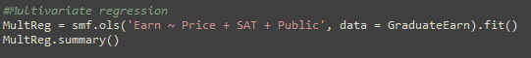
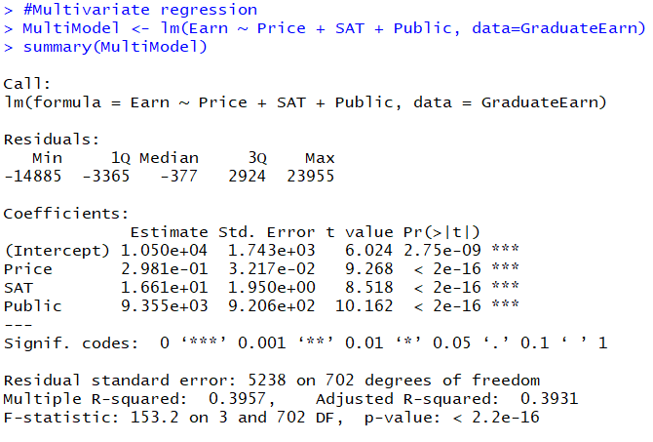
Multivariate Linear Regression (One DV, >1 IV, interpretation)

Slide 31
Multivariate Linear Regression (One DV, >1 IV, interpretation)
Price: We estimate that there is a $0.30 increase in earnings for every additional dollar spent on tuition adjusting for SAT scores and Public vs Private.
SAT: We estimate that there is a $16.61 increase in earnings for every additional point on the SAT adjusting for Price of Tuition and Public vs Private.
Public: We estimate that those who attend public institutions will earn on $9,355 more than those who attend private institutions after adjusting for SAT scores and Price of Tuition.

Slide 32
Multivariate Linear Regression (Prediction)
Earnings = 10,500 + (0.2981 * Price) + (16.61 * SAT) + (9,335 * Public)
Earnings = 10,500 + (0.2981 * 55,000) + (16.61 * 1450) + (9,335 * 1)
Earnings = $60,315

Slide 33
Multivariate Linear Regression (Prediction, Diagnostics, Assumptions)
Follows the same progression as shown in the Simple Linear Regression example:
Prediction
Check prediction accuracy with Train/Test method
Predict on current dataset
Diagnostics
Statistical Assumptions

Slide 34
Variable/Model Selection
Remember your end goal!
Prediction – Less concerned about interpretability (far more tolerant of complex models with lots of variables and interactions)
Prescriptive – Simple, interpretable model (not too much but not too little)
Omitting a variable you should have included
Introduces bias
Negative impact on the model
Including variables that are not important
Inflates your standard error
Increases R² artificially

Slide 35
Variable/Model Selection (two methods)
ANOVA Model Comparison – null hypothesis is that the models are equivalent
Stepwise Regression – iteratively searches the full scope of all variables (forward, backward) and uses AIC (Akaike Information Criteria) to select best model.
So many more!

Slide 36
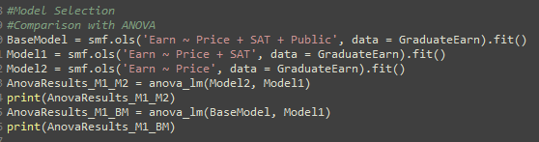
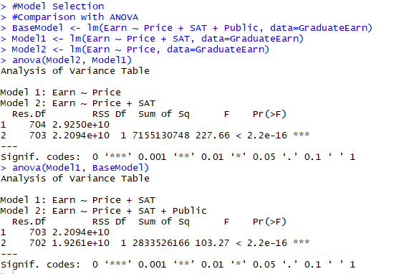
Variable/Model Selection (ANOVA method)

Slide 37

Variable/Model Selection (Stepwise Regression)
*look at script posted on SharePoint for how to replicate this with Python

Slide 38
Handling Variables (some notes)
Dummy Coding – Categorical variables with more than 2 levels can NOT go into the model “as is” (i.e. Car Type: 0 = car; 1 = truck, 2 = van)
Transformations – Data this is not normally distributed may need to be transformed (i.e. log transformation)
Interactions – In some cases, the an IV may vary in its effect on the DV based on the value of another IV, therefore you may need to add an interaction term (i.e. Variable 1 * Variable 2) Note: the original variables MUST be included in the model.
Continuous to Dichotomous/Categorical – Reduces the information from one variable.

Slide 39

Homework

Slide 40

Homework

